Slide 1

PROPOSAL
Conway’s game of life
By Yongjin Yang & Luxin Wang

Slide 2
01 Introduction
CONTENTS
02 Our Work
03 Future Work
— 2 —

Slide 3
01 Introduction
02 Our Work
03 Future Work
Conway's Game of Life
The Game of Life is a cellular automaton devised by the British mathematician John Horton Conway in 1970.
The universe of the Game of Life is an infinite, two-dimensional orthogonal grid of square cells, each of which is in one of two possible states, alive or dead, (or populated and unpopulated, respectively). Every cell interacts with its eight neighbors, which are the cells that are horizontally, vertically, or diagonally adjacent. At each step in time, the following transitions occur:
Any live cell with fewer than two live neighbors dies, as if by underpopulation.
Any live cell with two or three live neighbors lives on to the next generation.
Any live cell with more than three live neighbors dies, as if by overpopulation.
Any dead cell with exactly three live neighbors becomes a live cell, as if by reproduction.

Slide 4
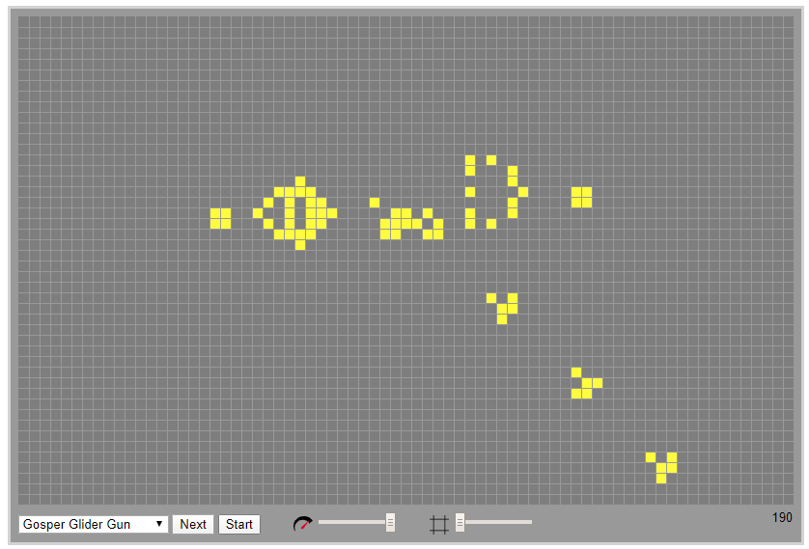
01 Introduction
02 Our Work
03 Future Work

Slide 5

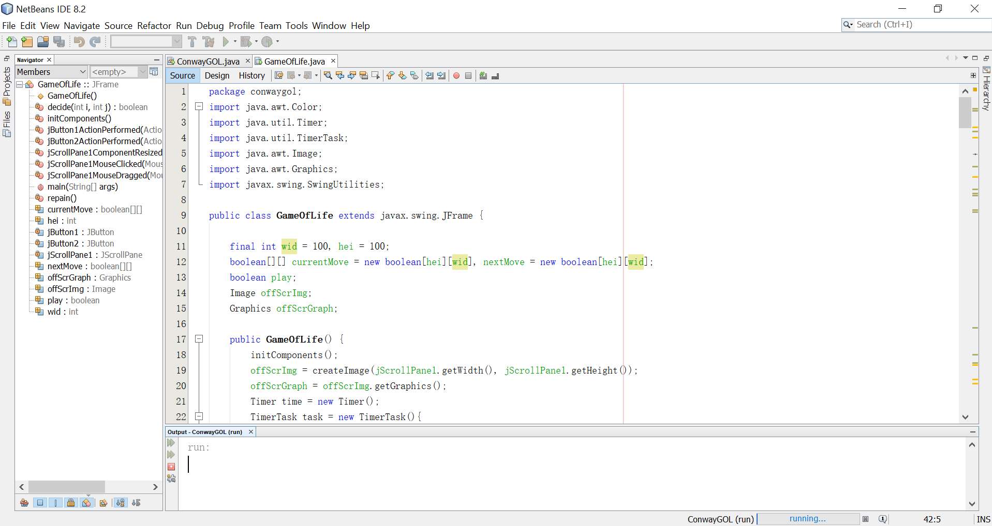
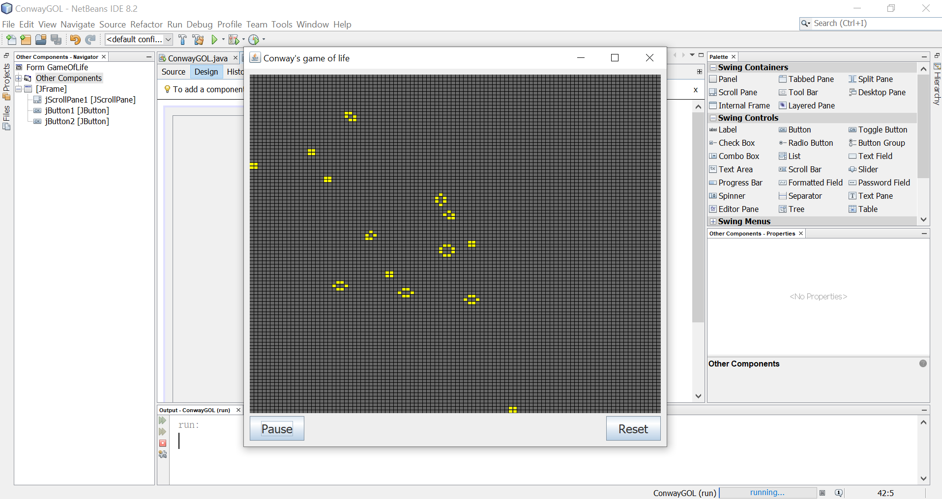
01 Introduction
02 Our Work
03 Future Work

Slide 6
01 Introduction
02 Our Work
03 Future Work
Test Time (Such as time required to run 1000 times)
Improve the speed (using parallel computing)
Can handle the large map
Create a 1000*1000 map, find out what makes the code slow and improve the speed.

Slide 7
Thank You

